Slide 1
08 | Getting prepared for automation
Jeffrey Snover | Distinguished Engineer & Lead Architect
Jason Helmick | Senior Technologist, Concentrated Technology

Slide 2
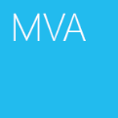

Course Topics
Getting Started with PowerShell
01 | Don’t fear the shell | 06 | The pipeline : Deeper
02 | The Help system | 07 | The Power in the Shell - Remoting
03 | The pipeline : Getting connected | 08 | Getting prepared for automation
04 | Extending the shell | 09 | Automation in scale - Remoting
05 | Objects for the Admin | 10 | Introducing scripting and toolmaking

Slide 3
Module Overview
PowerShell security goals
Execution Policy
Variables : a place to store stuff
Fun with Quotes
Getting and displaying input
Other output for scripts and automation

Slide 4
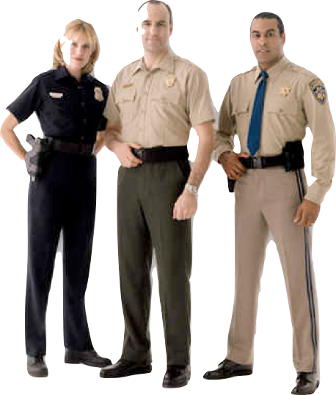
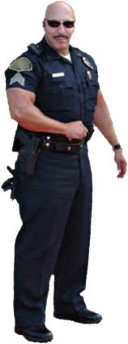
PowerShell security goals
Secured by default
Prevents mistakes by unintentional admins and users
No Script Execution
.Ps1 associated with notepad
Must type path to execute a script

Slide 5

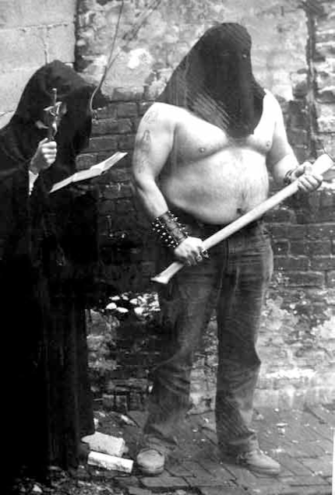
Execution Policy
By default, PowerShell does not run scripts.
Get/Set-ExecutionPolicy
Restricted
Unrestricted
AllSigned
RemoteSigned
Bypass
Undefined
Can be set with Group Policy

Slide 6



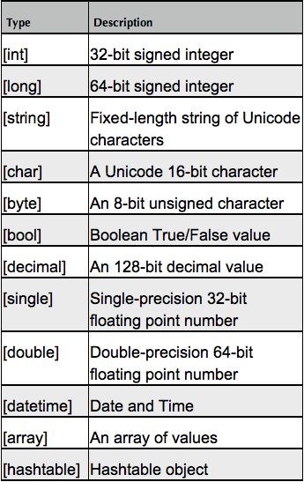
Variables: A place to store stuff
Use $ to create and use variables
Can contain letters, numbers, spaces and underscores
Don’t persist after Shell exits
New-Variable
Set-Variable
Get-Variable
Clear-Variable
Remove-Variable
Can force a type – [int]$var
Note: The $ is not part of the variable name, it’s a cue to access the contents of the variable

Slide 7
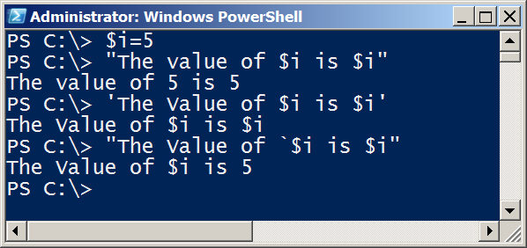
Fun with Quotes
Double Quotes resolve all variables
Can use Sub-Expressions
Single Quotes prevent substitution
Get-Help About_Quoting_Rules
Back-tick/Grave-Accent prevents individual substitution

Slide 8
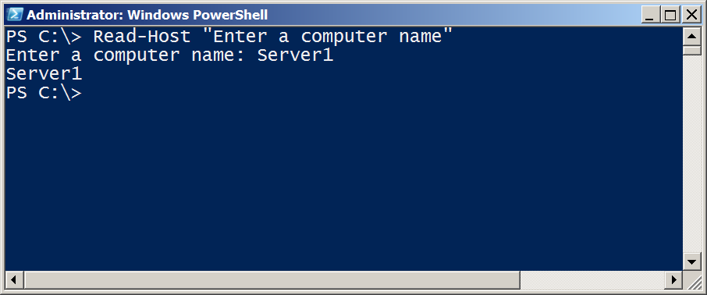
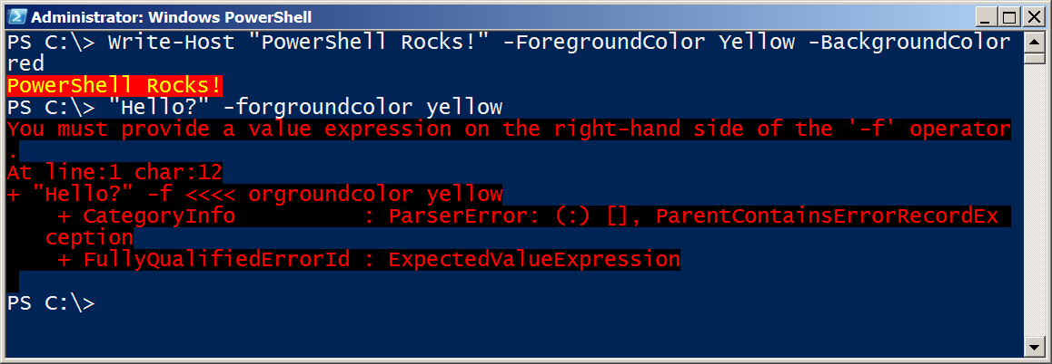
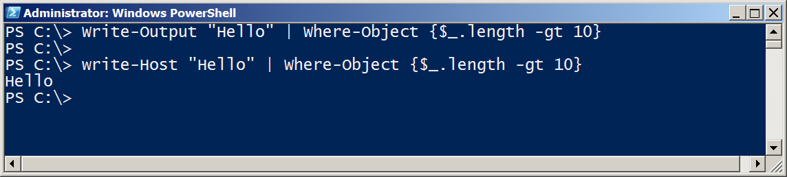
Getting and displaying input

Slide 9
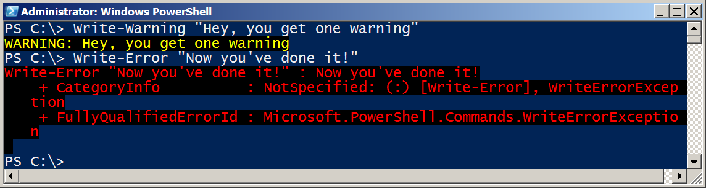
Other output for scripts and automation
Write-Warning
Write-Verbose
Write-Debug
Write-Error
$Preference variables to know
Help about_Preference_Variables
$DebugPreference=SilentlyContinue
$ErrorActionPreference=Continue
#VerbosePreference=SilentlyContinue

Slide 10
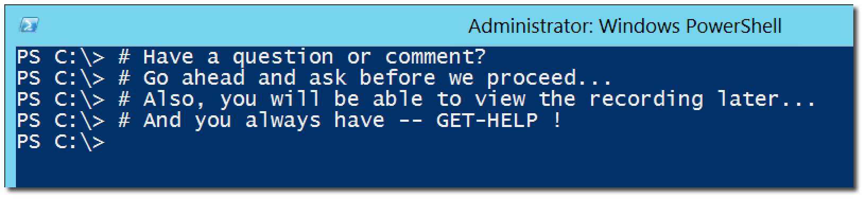
Questions or comments?

